Slide 1
REAL-TIME COMMUNICATION SYSTEM POWERED BY AI FOR SPECIALLY ABLED
SOLUTION ARCHITECTURE

Slide 2
PROBLEM STATEMENT:
Statement – In the recent years, there has been rapid increase in the number of deaf and dumb victims due to birth defects, accidents and oral diseases. Since deaf and dumb people cannot communicate with normal person so they have to depend on some sort of visual communication. A World Health Organization report says around 63 million people in India suffer from either complete or partial deafness, and of these, at least 50 lakh are children. Communication between deaf-mute and a normal person has always been a challenging task.
Description - The Deaf/Dump people needs a way to communicate easily and quickly with the normal people, so that the Deaf/Dump people feel confident enough to express there thought, ideas, and can make conversation with the normal people.

Slide 3
SOLUTION ARCHITECTURE:
Solution
The project aims to develop a system that converts the sign language into a human hearing voice or text in the desired language to convey a message to normal people, as well as convert speech or text into understandable sign language for the deaf and dumb.

Slide 4
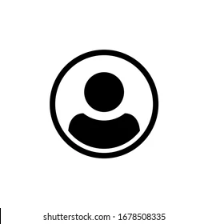
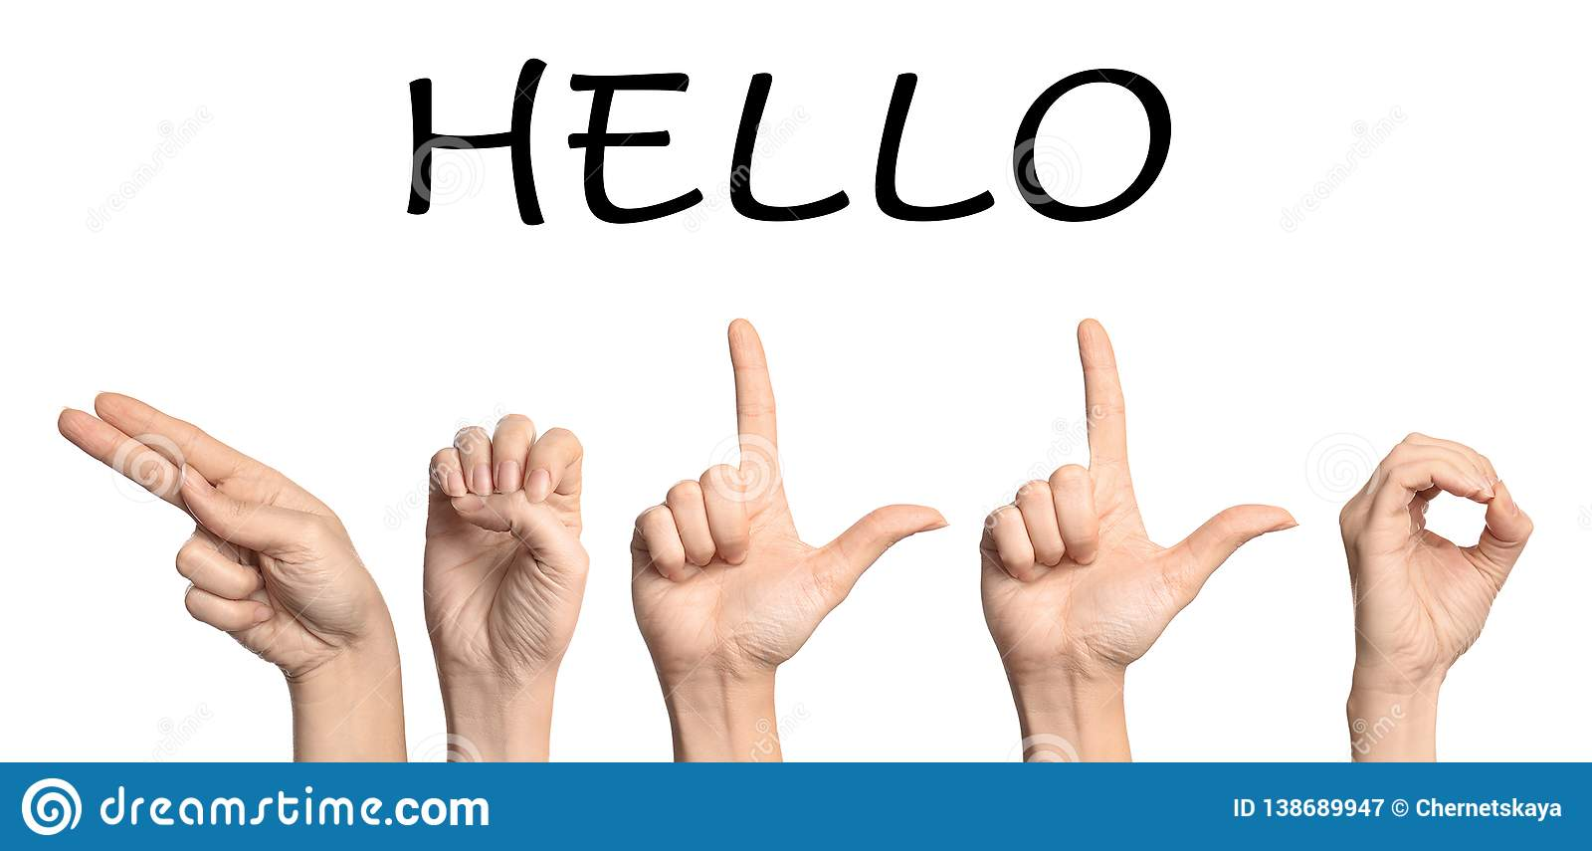

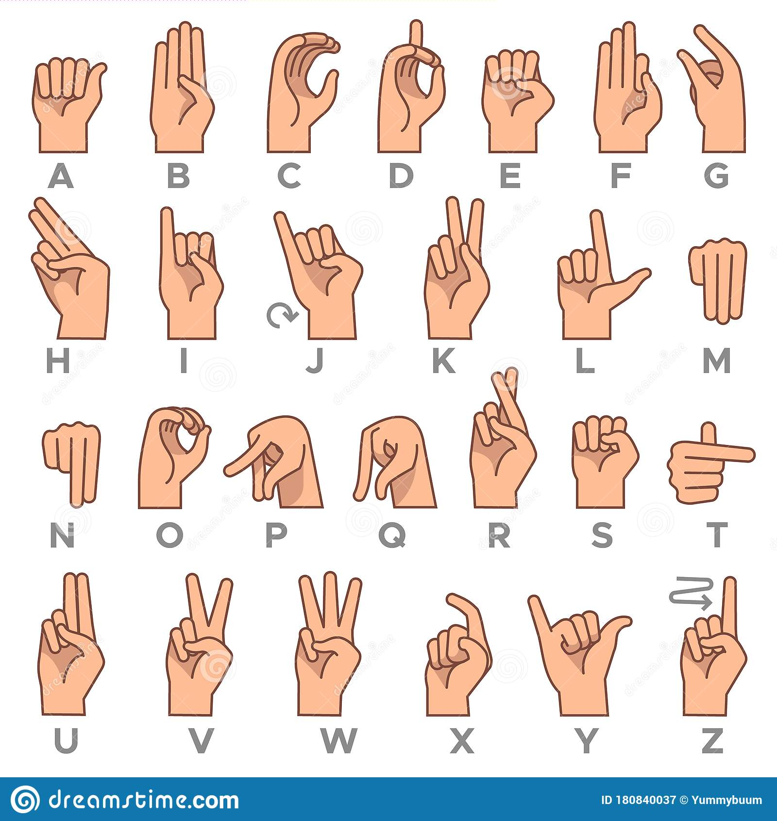

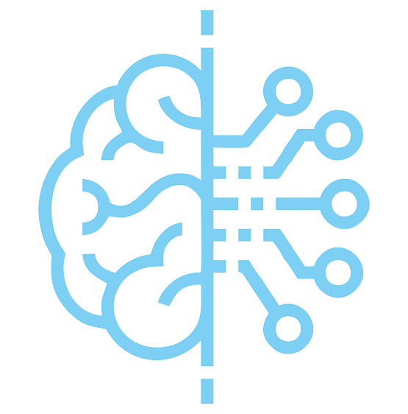


Image
Train data
User
WEB CAM
Neural network
Dataset
MODEL
Image processing
Evaluation
Test data
Output Prediction

Slide 5
Team ID : PNT2022TMID29964
Team Size : 5
Team Leader : KRITHIKSHA G
Team member : MONIKA Y
Team member : SUBHA SRI M
Team member : SEMBARUTHI N
Team member : NIVETHA N
Industry Mentor(s) Name : Shivani Kapoor, Indra Prakash, Mentor 8
Faculty Mentor(s) Name : SINDHUJA S

Slide 6
THANK YOU

